Slide 1

Cypurr Sessions
Digital Harassment and Doxxing
March 4th, 2018
Notes:
“La ingeniería de eq de fases comprende la aplicación del conocimiento fenomenológico del comportamiento de sistemas homogéneos y multifásicos, y su predicción mediante herramientas termodinámicas, con la finalidad de contribuir al desarrollo de procesos químicos. El diseño del equilibrio de fases es un nexo entre los requerimiento de un dado proceso y las actividades académicas de medición y modelado de datos experimentales.
[…] Esta disponibilidad (de simuladores computacionales) hace necesario estudiarla, con la finalidad de alcanzar un uso más fehaciente y efectivo de éstos, a través del desarrollo de criterios generales que faciliten la comprensión del potencial y limitaciones del proceso químico.”
Pereda, tesis doctoral, PLAPIQUI/UNS 2003, pp 4.1.

Slide 2
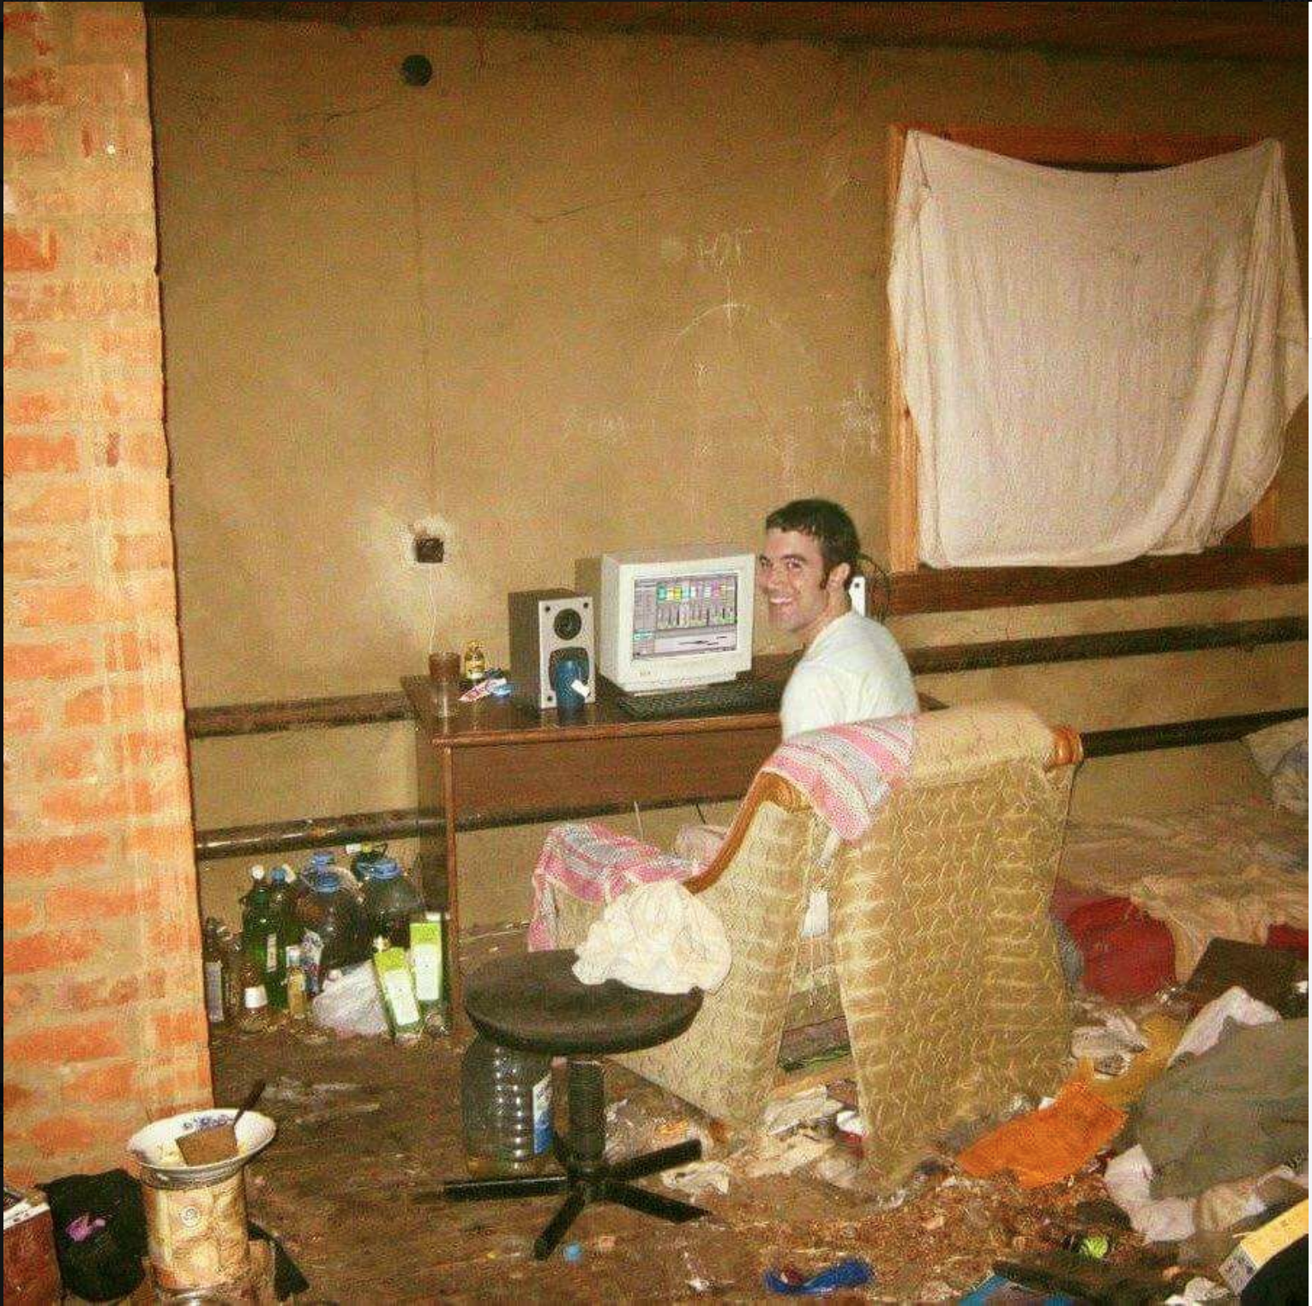
WELCOME!

Slide 3
Outline
Introduction
Rules n’ Such
Current Events
Cyber Harassment/Doxxing
Let’s Talk!
Thank You/Resources
Notes:
Ability concerns contact
Assisting with needs
Breaks
“Can everyone see [me/ the board/ the screen/ the main point of focus]?”
“Can everyone hear me at this volume? Am I speaking at a good pace?”
New words/phrases

Slide 4
Who are we? Who are you?
We are the…
The Cypurr Collective: A group of folks that organize cybersecurity workshops and socials, looking to spread knowledge and talk about privacy rights!
...and you are?
Name
Pronouns (i.e. he/him, she/her, they/them, ze/zer, etc)
In a few words, what brings you here today?

Slide 5

A few rules for this workshop …
Share the space!
Step Up Step Back: Ask a question, give a comment, leave room for others to speak
Stack!
Raise your hand and we will put you on the speaking queue
Saf(er) Space
We DO NOT tolerate language or behavior purposefully meant to demean or harm folks based on their identities
No one should be forced to discuss their own experience/threat model/situation
Consent: Ask before helping someone out, before taking their device
Photo/Video- No photo/video without asking!
Bonus Rule: Try not to invalidate experiences!

Slide 6
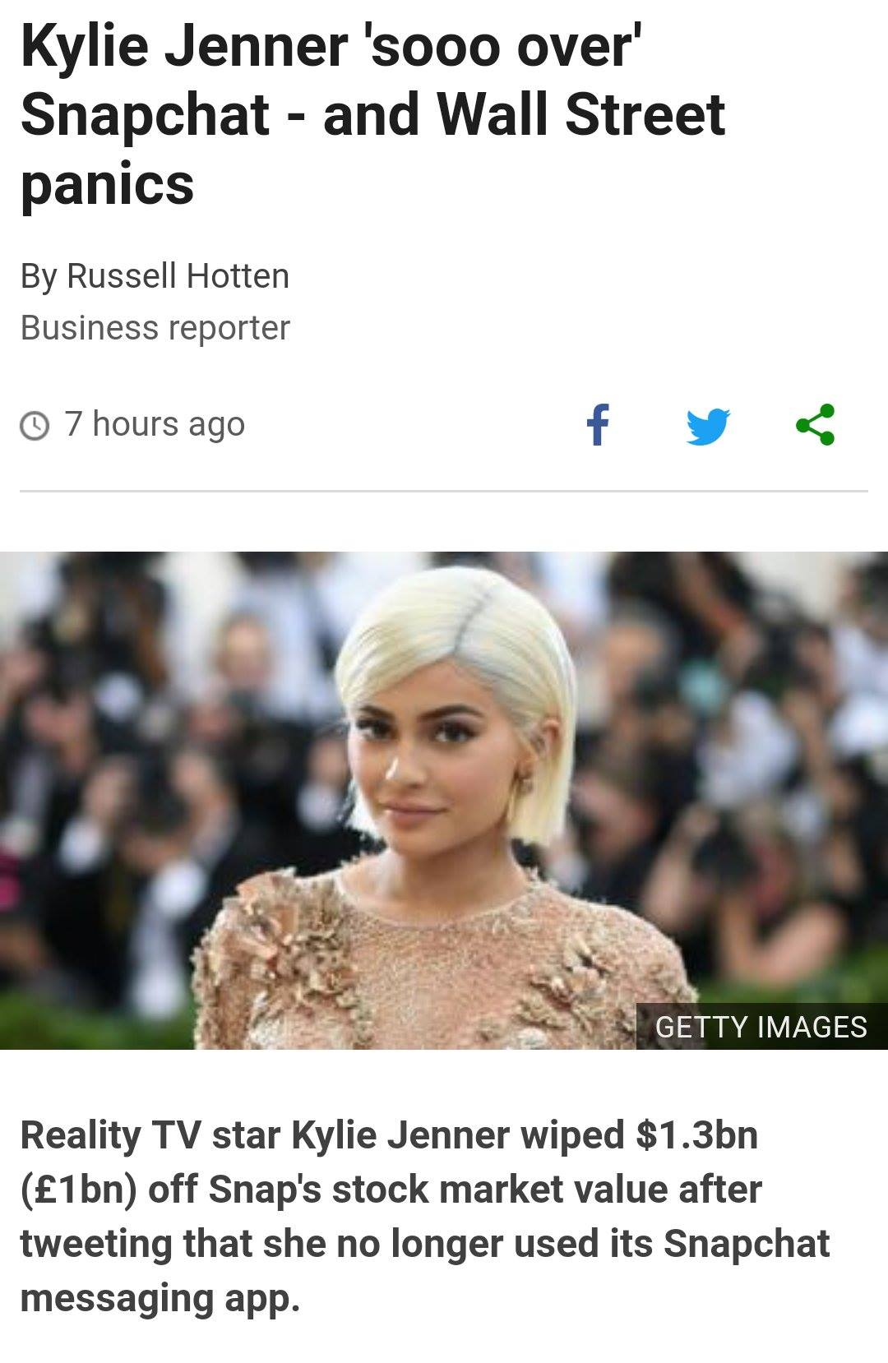
Current Events!

Slide 7

WHAT’S ON YOUR MIND?

Slide 8
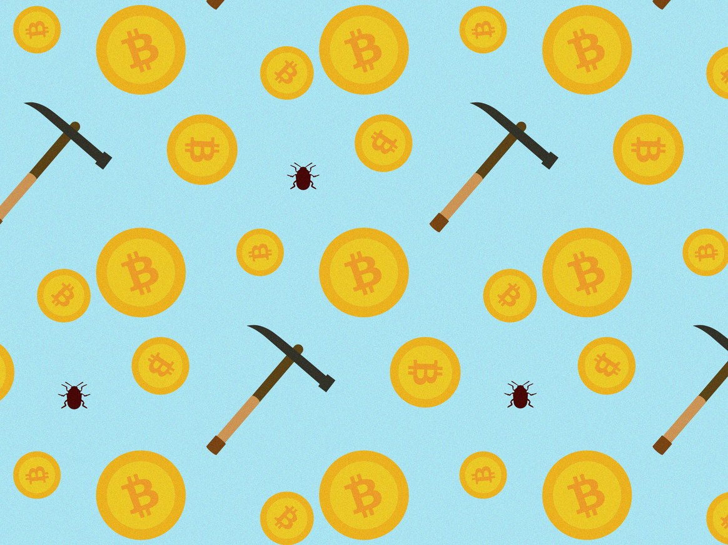
Story #1: There’s gold in them scripts!
CryptoJacking Has Gotten Out of Control
December 29, 2017

Slide 9
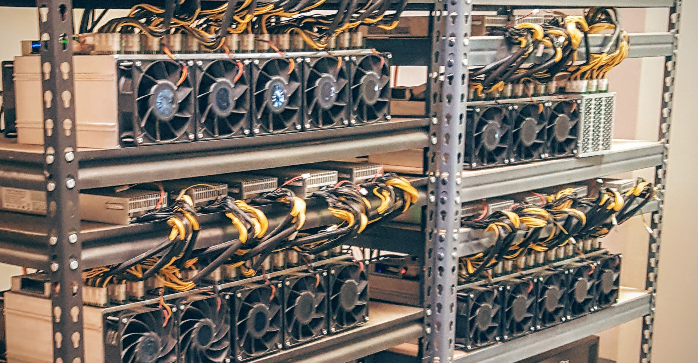
The Story?
Hackers are sneaking in code onto websites to use visitor’s extra CPU power to mine Crypto Currency
The process of “mining” crypto currency is how crypto currency is generated. The more you mine the more currency you get
This process could take a lot of time and energy to complete

Slide 10
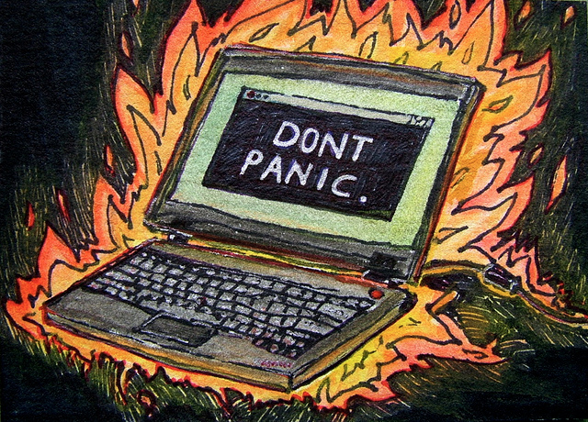
The Threat?
“One type of Android malware, called Loapi, mines cryptocurrency so intensely that it can cause physical harm to the devices it runs on.”
In another innovation from November, security researchers at Malwarebytes Labs discovered that some cryptojackers had found a way to persist even after users closed the mining tab. To do so, the cryptojacker opens a stealthy browser window called a "pop-under" that hides behind the Windows taskbar clock.

Slide 11
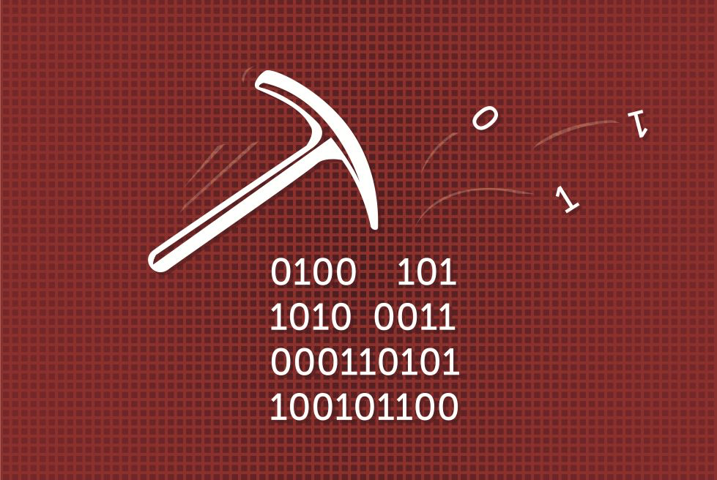
What To Do?
More browsers are looking to block CryptoJacking
Proof of Work Captcha
Still, might become a legitimized service in coming years (with users consent) changing face of internet usage

Slide 12
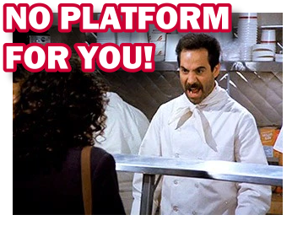
Story #2: No Platform
YouTube Bans Channel of American Neo-Nazi Extremist Group Atomwaffen Division
Motherboard, February 28th, 2018

Slide 13

The Story?
“YouTube has banned a channel belonging to Atomwaffen Division, an American neo-Nazi group that has been linked to several murders, for violating the platform’s hate speech policies.”
“The action was not swift, however: the ban comes days after a flurry of media attention on Atomwaffen and YouTube’s inaction around the group, and on Tuesday the Anti-Defamation League asked YouTube to remove offending videos immediately.”

Slide 14

The Threat?
Recruitment Tool
Spreading/Popularizing hate speech
Atomwaffen has been connected to harassment of gay and/or Jewish folk, as well as a couple murders

Slide 15

What To Do?
Take some time to report stuff!
Youtube
Social Media
No Platform for Fascism, the extension!
Firefox
Chrome
Panel on Digital Activism on March 24th at Interference Archive

Slide 16
STRETCH BREAK

Slide 17

Doxxing &
Cyber Harassment

Slide 18
Some Definitions...
Cyberbullying/Cyber Harassment
“bullying that takes place over digital devices like cell phones, computers, and tablets. Cyberbullying can occur through SMS, Text, and apps, or online in social media, forums, or gaming where people can view, participate in, or share content.”
Doxxing
“a technique of tracing someone or gather information about an individual using sources on the internet. Its name is derived from “Documents” or “Docx”. Doxing method is based purely on the ability of the hacker to recognize valuable information about his target and use this information to his benefit.”
Notes:
Flaming: This is an aggressive exchange between two or more people online.
Impersonation: Technology allows people to post or comment as others if they have gained access to another’s account. This can be used to bully.
Cyber Stalking: Social media and messaging gives stalkers new opportunities to contact follow and harass their victims.
Outing: Direct access to large groups of people can make outing, sharing secrets and other personal information all the more hurtful.
Trolling: This involves trying to wind up others online with immature questions or mean comments.

Slide 19
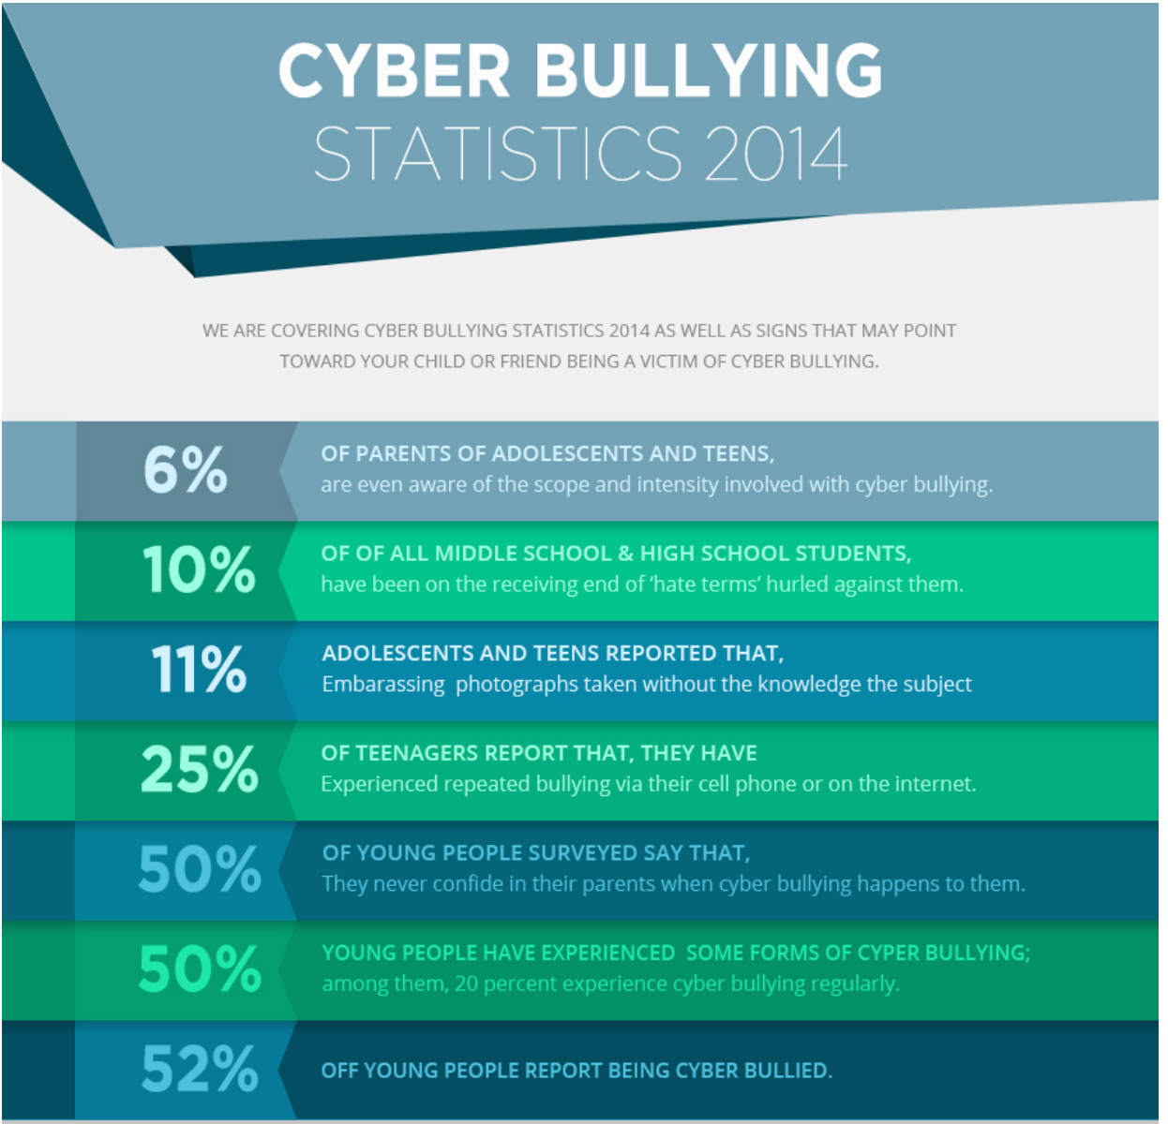
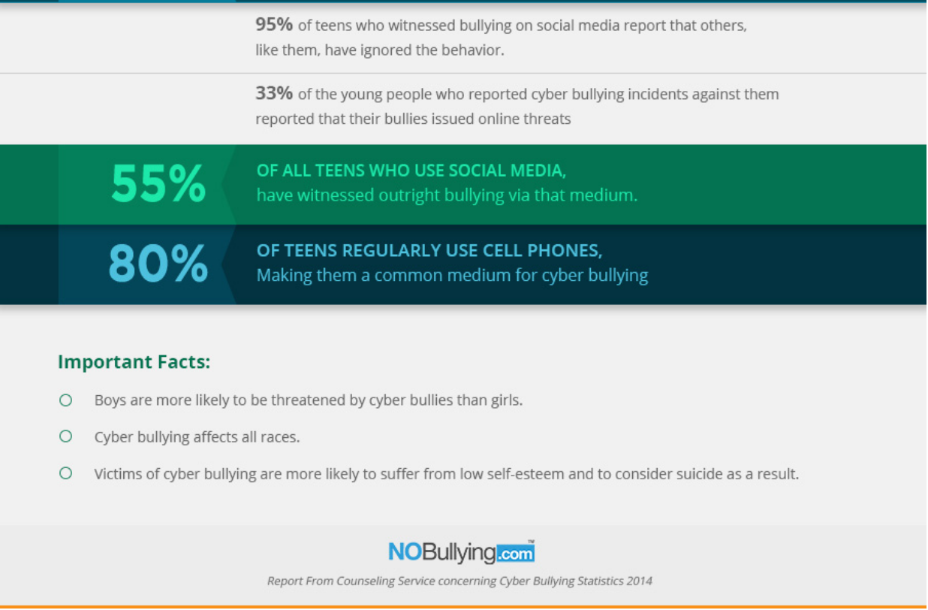
Context
-stats from NoBullying.com
Notes:
Anonymity: These bullies often cruise the Internet under pseudonyms, often the victim often does not know who is doing the bullying.
Accessibility: The cyber bully can approach his victim at any time over the Internet. Since the contact is not physical or face-to-face there is no specific time during which the bully has access.
Punitive Fears: Victims often fear retaliation from their tormentors. If the victim is a child, the fear of losing access to a computer or other technology may prevent them from seeking help or reporting the behaviour.
Disinhibition: The anonymity of the Internet can encourage an individual to commit acts they might not otherwise attempt in person. It affords false courage when the bully thinks he can’t be identified.
40% of Adult Online Users experienced- Ad Week

Slide 20

Context (contd.)
“Doxing is not new; the term dates back to 2001 and the hacker group Anonymous. But it can be incredibly offensive. In 2014, several women were doxed by male gamers trying to intimidate them into keeping silent about sexism in computer games.
Companies can be doxed, too. In 2011, Anonymous doxed the technology firm HBGary Federal. In the past few weeks we've witnessed the ongoing doxing of Sony.”
-Bruce Schneier
Notes:
Anonymity: These bullies often cruise the Internet under pseudonyms, often the victim often does not know who is doing the bullying.
Accessibility: The cyber bully can approach his victim at any time over the Internet. Since the contact is not physical or face-to-face there is no specific time during which the bully has access.
Punitive Fears: Victims often fear retaliation from their tormentors. If the victim is a child, the fear of losing access to a computer or other technology may prevent them from seeking help or reporting the behaviour.
Disinhibition: The anonymity of the Internet can encourage an individual to commit acts they might not otherwise attempt in person. It affords false courage when the bully thinks he can’t be identified.
40% of Adult Online Users experienced- Ad Week

Slide 21

Sources/Targets of Doxxing
Looking for...
Name
Address
Profiles
Images
Passwords
Forms of Contact
Phone
Email
Sources
Social Media
Data Broker Sites
Search Engines
Public Records
Email
Phishing
WHOIS

Slide 22
Harm Reduction Re: Doxxing
Understand your “Digital Footprint”
Search yourself on a search engine like Google
Take a look at your public posts on Social Media
Be aware of what you share!
Check out MyShadow.org for more!
Remove Yourself- Long process, but can start with 10 min per day!
Take yourself off Google
Take down or make private photos on social media
Submit requests to data sites
Check out some Anti-Doxxing Resources
Data Detox Kit
SSD by EFF
Crash Override Network
Privacy Duck (paid)

Slide 23
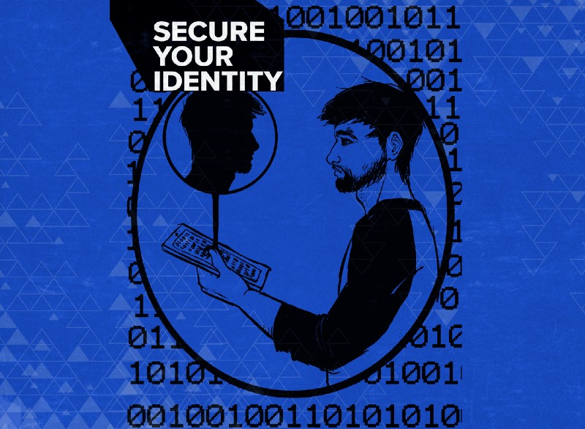
Harm Reduction Re: Doxxing
Tips from Equality Labs
Create Self-Care Plan
Create Incident Log
Change Passwords, Password Managers, 2FA
Call credit card company, utilities, and bank if financially targeted
Change Privacy Settings on Social Media
Delete old, unused accounts
Use aliases
Get to know secure apps/methods of surfing
VPN
Tor
Signal
Protonmail

Slide 24

Let’s Talk About It!

Slide 25
Thank You and Resources
Sources
Crash Override Network- http://www.crashoverridenetwork.com/
Equality Labs Anti-Doxxing Guide on Medium https://medium.com/@EqualityLabs/anti-doxing-guide-for-activists-facing-attacks-from-the-alt-right-ec6c290f543c
Privacy Duck- https://www.privacyduck.com/
Articles
“Doxxing as Attack”- Bruce Schneier
NoBullying.com
“Study: 40% of Adults Experience Cyberbullying”- AdWeek

Slide 26
Thank You and Resources
CyPurr Collective on Facebook for Future events!
Sign up to our email list too, we won’t spam ya!
Further Resources
NYC CryptoParty Meetup/CryptoParty Harlem (Meetup)
HacbBlossom (Hackblossom.org)
Tactical Tech Collective-
Holistic Security,
MyShadow
Data Detox
EFF- Surveillance Self Defense (ssd.eff.org)
Freedom of the Press Foundation (Freedom.press)

